Slide 1
media spaces
dr. carman neustaedter

Slide 2
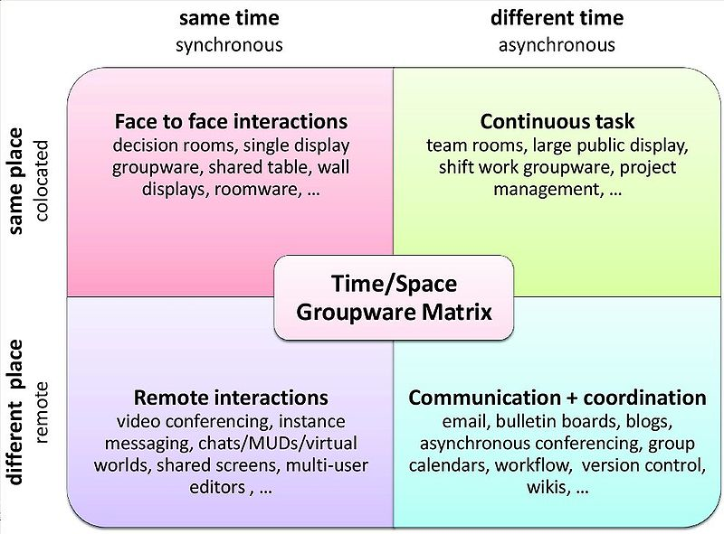

Slide 4
media spaces
media spaces

Slide 5
the workplace

Slide 6
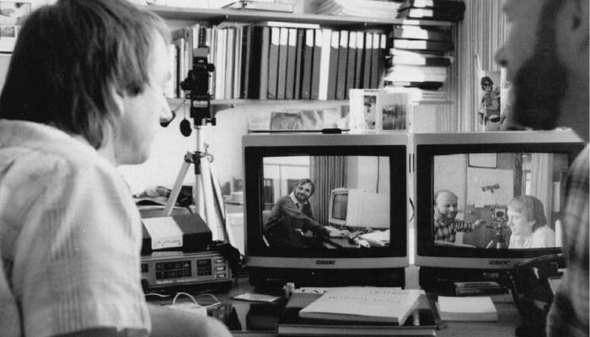
media spaces
Notes:
A media space is an always-on video and audio connection
These media spaces were successful in connecting distance-separated colleagues by providing awareness information, which let people easily move into communication
Problem: privacy concerns

Slide 7
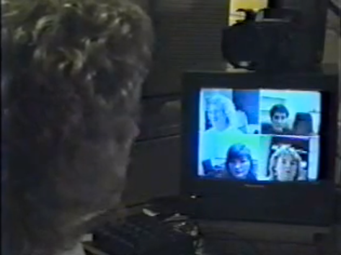
hydra – a multi-party video conference system
http://www.youtube.com/watch?v=n-W7QTXG4G8

Slide 8
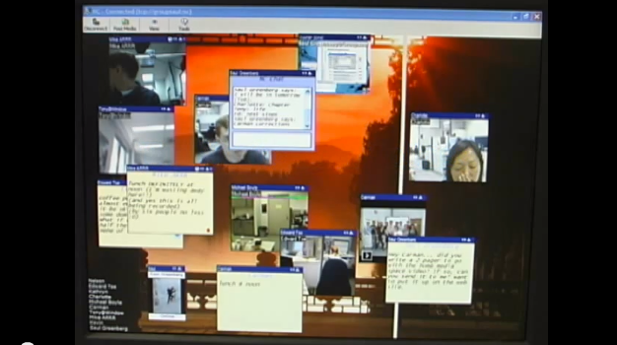
the notification collage
http://www.youtube.com/watch?v=ov9vSdmON84

Slide 9
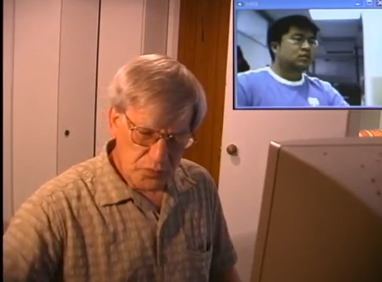
the home media space
http://www.youtube.com/watch?v=gzWbW3pBFjA

Slide 10
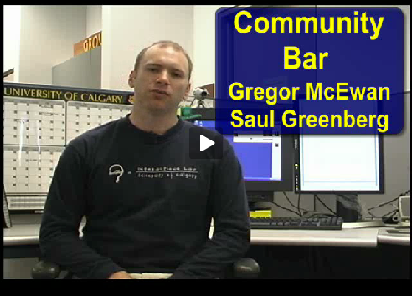
the community bar
http://grouplab.cpsc.ucalgary.ca/Publications/2005-CommunityBarVideo.ECSCW

Slide 11
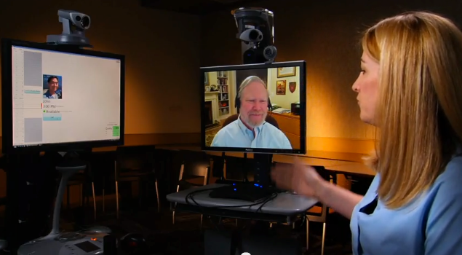
embodied social proxies
http://www.youtube.com/watch?v=fBHjOyDtI3g

Slide 12
focal questions
what are important focal activities?
what are the social questions?
what are the technical questions?
how can we design for each activity?
how do people learn to use these systems?
how do people understand these systems?

Slide 13
the home

Slide 14
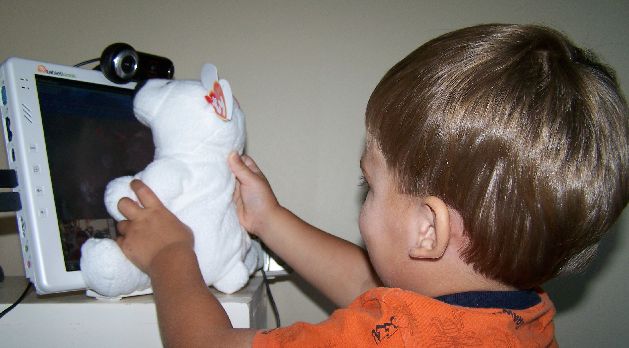
the family window
http://clab.iat.sfu.ca/uploads/Main/FamilyWindowVideo.wmv

Slide 15
family story play
http://vimeo.com/6874085

Slide 16
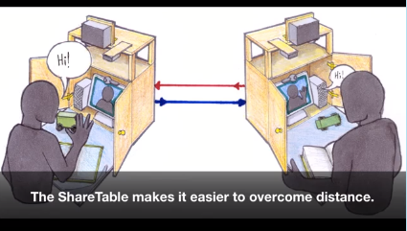
the share table
https://sites.google.com/site/sharetable/

Slide 17
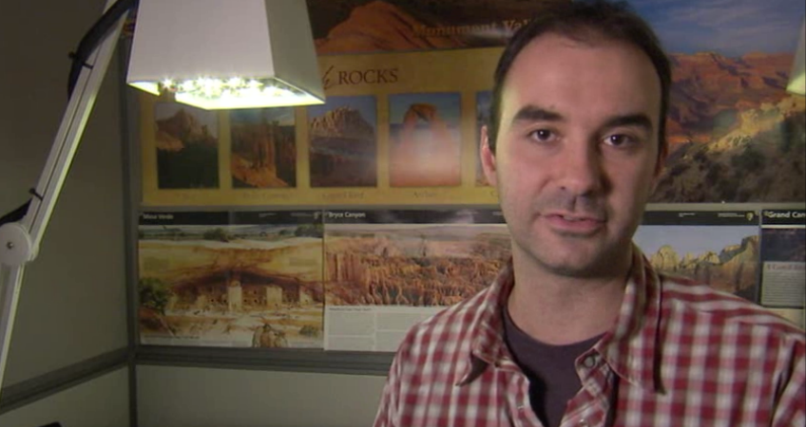
illumishare
http://research.microsoft.com/en-us/projects/illumishare/

Slide 18
focal questions
what are important focal activities?
what are the social questions?
what are the technical questions?
how can we design for each activity?
how do people learn to use these systems?
how do people understand these systems?

